Slide 1
Advanced Game Movement Session 04
Course : COMP6228 – Artificial Intelligence
Effective Period : February 2018

Slide 2
Learning Objective
After completing this session, students are expected to be able to:
LO 1 : Describe how Artificial Intelligence works in Games
LO 2 : Explain concepts of AI Techniques in Games

Slide 3
Content
Jumping
Jump Points
Landing Pads
Hole Filters
Coordinated Movement
Formations
Slot
Motor Control
Output Filtering
Capability-Sensitive Steering
Movement in Third Dimension
Rotation in Three Dimension
Align
Face

Slide 4
Jumping: Jump Points
The simplest support for jumps puts the onus on the level designer. Locations in the game level are labelled as being jump points.
These regions need to be manually placed. If characters can move at many different speeds, then jump points also have an associated minimum velocity set.
This is the velocity at which a character needs to be traveling in order to make the jump.

Slide 5
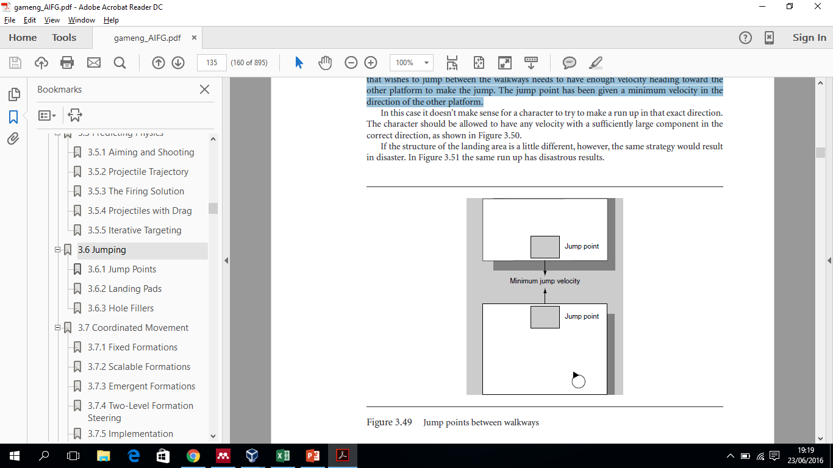
Jumping: Jump Points
A character that wishes to jump between the walkways needs to have enough velocity heading toward the other platform to make the jump.
The jump point has been given a minimum velocity in the direction of the other platform.
Jump points between walkways

Slide 6
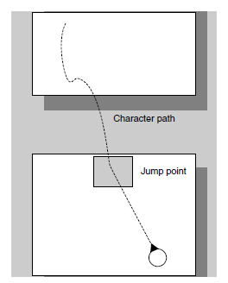
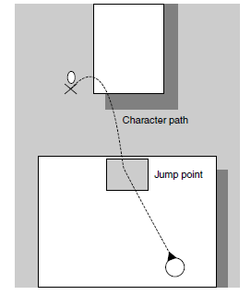
Jumping: Jump Points
Flexibility in the jump velocity
A jump to a narrower platform

Slide 7
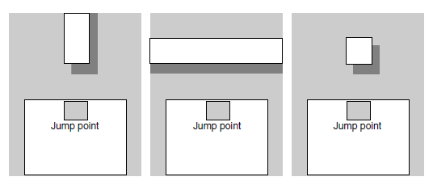
Jumping: Jump Points
Three cases of difficult jump points
Different jumps that are difficult to mark up using jump points:
Jumping onto a thin walkway requires velocity in exactly the right direction
jumping onto a narrow ledge requires exactly the right speed
jumping onto a pedestal involves correct speed and direction

Slide 8
Jumping: Landing Pads
A better alternative is to combine jump points with landing pads.
A landing pad is another region of the level, very much like the jump point.
Each jump point is paired with a landing pad. We can then simplify the data needed in the jump point. Rather than require the level designer to set up the required velocity, we can leave that up to the character.
When the character determines that it will make a jump, it adds an extra processing step. Using trajectory prediction code similar to that provided in the previous section, the character calculates the velocity required to land exactly on the landing pad when taking off from the jump point. The character can then use this calculation as the basis of its velocity matching algorithm.

Slide 9
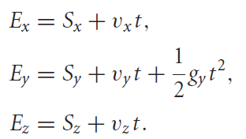
Jumping: Landing Pads
The Trajectory Calculation
The trajectory calculation is slightly different to the firing solution discussed previously.
In the current case we know the start point S, the end point E, the gravity g , and the y component of velocity vy . We don’t know the time t or the x and z components of velocity. We therefore have three equations in three unknowns:

Slide 10
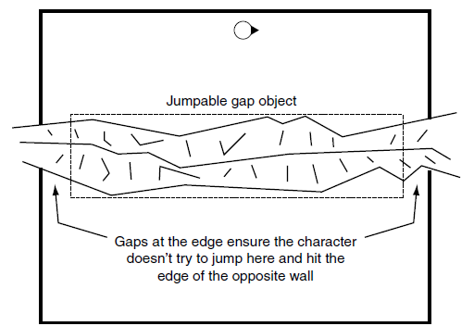
Jumping: Hole Fillers
Another approach used by several developers allows characters to choose their own jump points. The level designer fills holes with an invisible object, labeled as a jumpable gap.
We can easily support one-directional jumps. If one side of the chasm is lower than the other, we could set up the situation. In this case the character can jump from the high side to the low side, but not the other way around. In fact, we can use very small versions of this collision geometry in a similar way to jump points
A one-direction chasm jump

Slide 11
Formations
Games increasingly require groups of characters to move in a coordinated manner. Coordinated motion can occur at two levels. The individuals can make decisions that compliment each other, making their movements appear coordinated.
Formation motion is the movement of a group of characters so that they retain some group organization. At its simplest it can consist of moving in a fixed geometric pattern such as a V or line abreast, but it is not limited to that.
Formations can also make use of the environment.

Slide 12
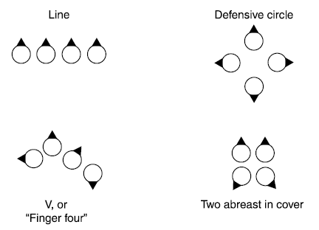
Formations:
Fixed Formations
A selection of formations
One slot is marked as the leader’s slot. All the other slots in the formation are defined relative to this slot. Effectively, it defines the “zero” for position and orientation in the formation.

Slide 13
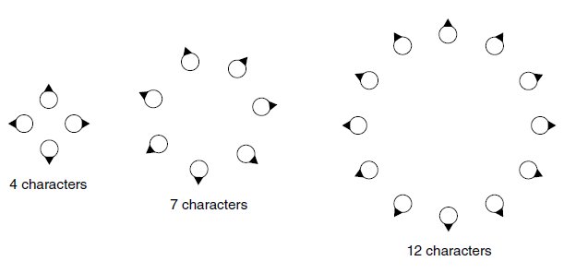
Formations:
Scalable Formations
In many situations the exact structure of a formation will depend on the number of characters that are participating in it.
A defensive circle, for example, will be wider with 20 defenders than with 5.
With 100 defenders, it may be possible to structure the formation in several concentric rings.
A defensive circle formation with different numbers of characters

Slide 14
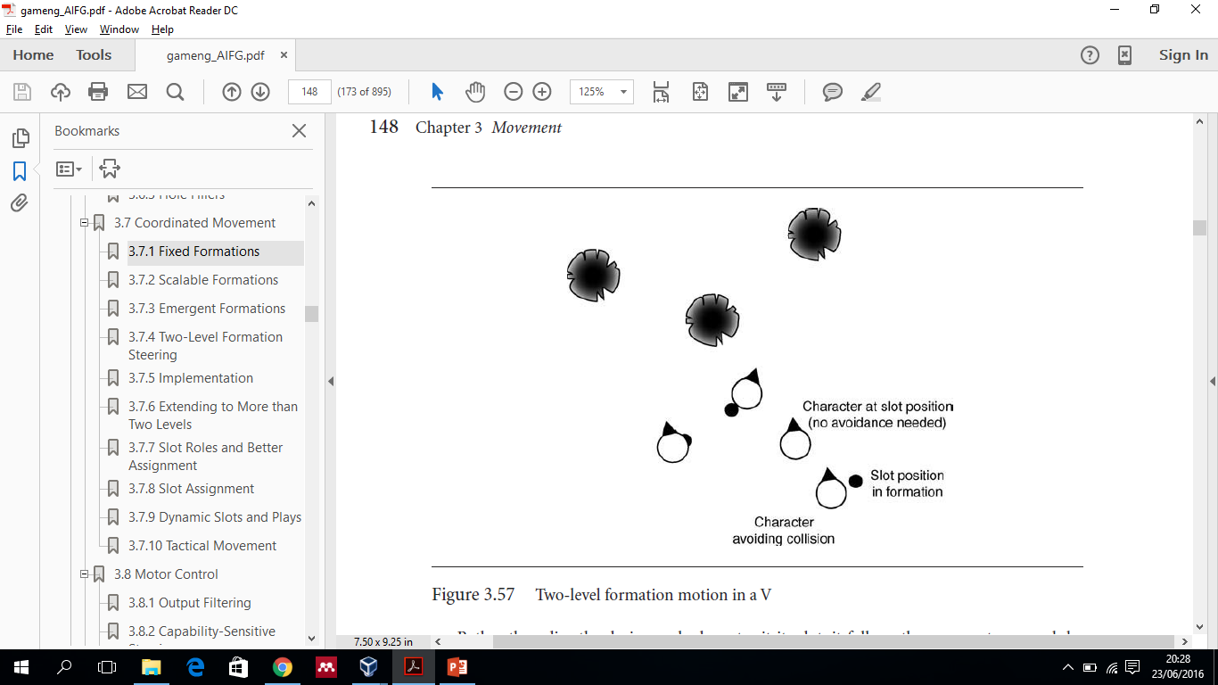
Formations:
Two-Level Formation Steering
We can combine strict geometric formations with the flexibility of an emergent approach using a two-level steering system.
We use a geometric formation, defined as a fixed pattern of slots, just as before.
Two-level formation motion in a V

Slide 15
Formations:
Two-Level Formation Steering
Rather than directly placing each character it its slot, it follows the emergent approach by using the slot at a target location for an arrive behavior.
Characters can have their own collision avoidance behaviors and any other compound steering required.
This is two-level steering because there are two steering systems in sequence: first the leader steers the formation pattern, and then each character in the formation steers to stay in the pattern.
As long as the leader does not move at maximum velocity, each character will have some flexibility to stay in its slot while taking account of its environment.

Slide 16
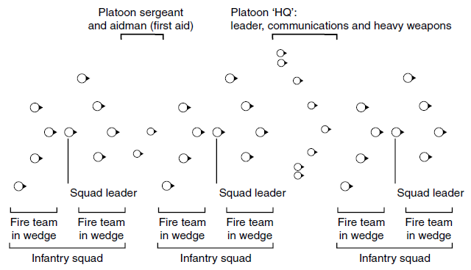
Formations:
Extending to More than Two Levels
The two-level steering system can be extended to more levels, giving the ability to create formations of formations.
This is becomingly increasingly important in military simulation games with lots of units; real armies are organized in this way.
Nesting formations to greater depth

Slide 17
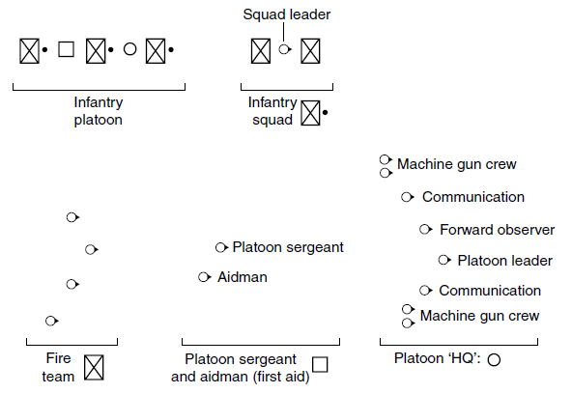
Formations:
Extending to More than Two Levels
Nesting formations shown individually

Slide 18
Slot: Roles
Slots in a formation can have roles so that only certain characters can fill certain slots.
When a formation is assigned to a group of characters (often, this is done by the player), the characters need to be assigned to their most appropriate slots.
Whether using slot roles or not, this should not be a haphazard process, with lots of characters scrabbling over each other to reach the formation.

Slide 19
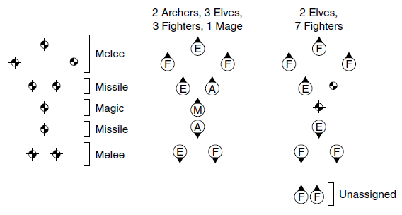
Slot: Roles
An RPG formation, and two examples of the formation filled

Slide 20
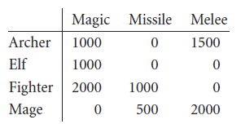
Slot: Roles
We would like to assign characters to slots in such a way that the total cost is minimized. If there are no ideal slots left for a character, then it can still be placed in a non-suitable slot. The total cost will be higher, but at least characters won’t be left stranded with nowhere to go. In our example, the slot costs are given for each role below:
These flexible slot costs are called soft roles. They act just like hard roles when the formation can be sensibly filled but don’t fail when the wrong characters are available.

Slide 21
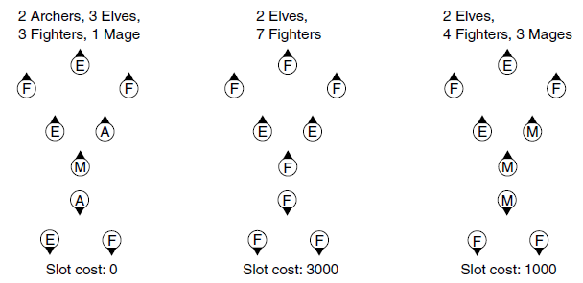
Slot: Roles
Different total slot costs for a party

Slide 22
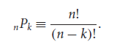
Slot:
Slot Assignment
Slot assignment needs to happen relatively rarely in a game. Most of the time a group of characters will simply be following their slots around.
Assignment usually occurs when a group of previously disorganized characters are assigned to a formation. We will see that it also occurs when characters spontaneously change slots in tactical motion.
For large numbers of character and slots, the assignment can be done in many different ways. The number of possible assignments of k characters to n slots is given by the permutations formula:
For a formation of 20 slots and 20 characters, this gives nearly 2500 trillion different possible assignments.

Slide 23
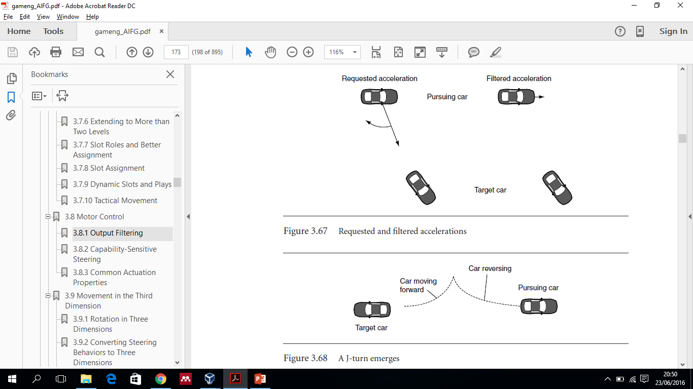
Motor Control:
Output Filtering
The simplest approach to actuation is to filter the output of steering based on the capabilities of the character.
A filtering algorithm simply removes all the components of the steering output that cannot be achieved. The result is for no angular acceleration and a smaller linear acceleration in its forward direction.
A J-turn emerges
Requested and filtered accelerations

Slide 24
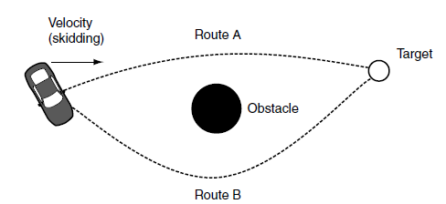
Motor Control:
Capability-Sensitive Steering
A different approach to actuation is to move the actuation into the steering behaviors themselves.
Rather than generating movement requests based solely on where the character wants to go, the AI also takes into account the physical capabilities of the character.
Heuristics make the right choice

Slide 25
Movement in the Third Dimension: Rotation in Three Dimensions
Full 3D movement is required if your characters aren’t limited by gravity. Characters scurrying along the roof or wall, airborne vehicles that can bank and twist, and turrets that rotate in any direction are all candidates for steering in full three dimensions.
To move to full three dimensions we need to expand our orientation and rotation to be about any angle. Both orientation and rotation in three dimensions have three degrees of freedom. We can represent rotations using a 3D vector.

Slide 26
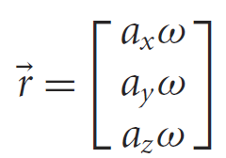
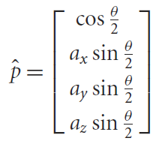
Movement in the Third Dimension: Rotation in Three Dimensions
The rotation vector has three components. It is related to the axis of rotation and the speed of rotation according to:
The axis and angle are converted into a quaternion using the following equation:

Slide 27
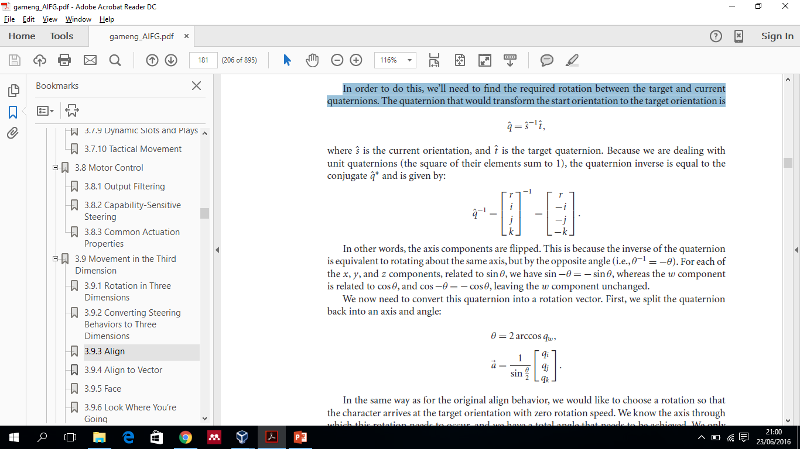
Movement in the Third Dimension: Align
Align takes as input a target orientation and tries to apply a rotation to change the character’s current orientation to match the target.
In order to do this, we’ll need to find the required rotation between the target and current quaternions. The quaternion that would transform the start orientation to the target orientation is

Slide 28
References
Ian Millington. 2009. Artificial intelligence for games. Morgan Kaufmann Publishers. Burlington. ISBN:9780123747310
Game Movement, http://www.w3schools.com/graphics/game_movement.asp

